Slide 1
Digital Fellows and Extension Projects
Laura Niesen de Abruna
ACAO and PI, Digital Fellows Grant
Bill & Melinda Gates Foundation

Slide 2
Digital Learning as Gateway for Improved Student Success
What is Adaptive Learning?
An innovative use of digital learning is provided by digital courseware. This refers to instructional content that is designed and sequenced to offer an entire course packet in lieu of a physical textbook or sometimes in addition to a textbook. Students access this course software and receive personalized assessment and digital “coaching” as the program directs them to additional work that helps them understand content. They cannot proceed from one section to another without mastering content.
It is sometimes called “adaptive hinting.”

Slide 3
Bill & Melinda Gates Foundation Project with Chief Academic Officers
I worked with Bill & Melinda Gates Program Officers Jim Ptaszynski and Bree Olfson and others in the Post-Secondary Success Division on a $1.2 Million project to develop the engagement of Chief Academic Officers with digital learning. The Digital Fellows program was created for 31 Chief Academic Officers and their faculty members in universities across the country.

Slide 4
Digital Fellows Program
There were:
16 men and 16 women
9 community colleges and 23 4-year institutions
2 state systems
6 HSIs and 2 HBCUs
5 private non-profits
2 private for-profits
They come from a diversity of states, from Florida to Alaska, from Texans to California, and Maine to Washington, but also from Georgia, North Dakota, Minnesota, Ohio and West Virginia, North Carolina and Massachusetts.

Slide 5
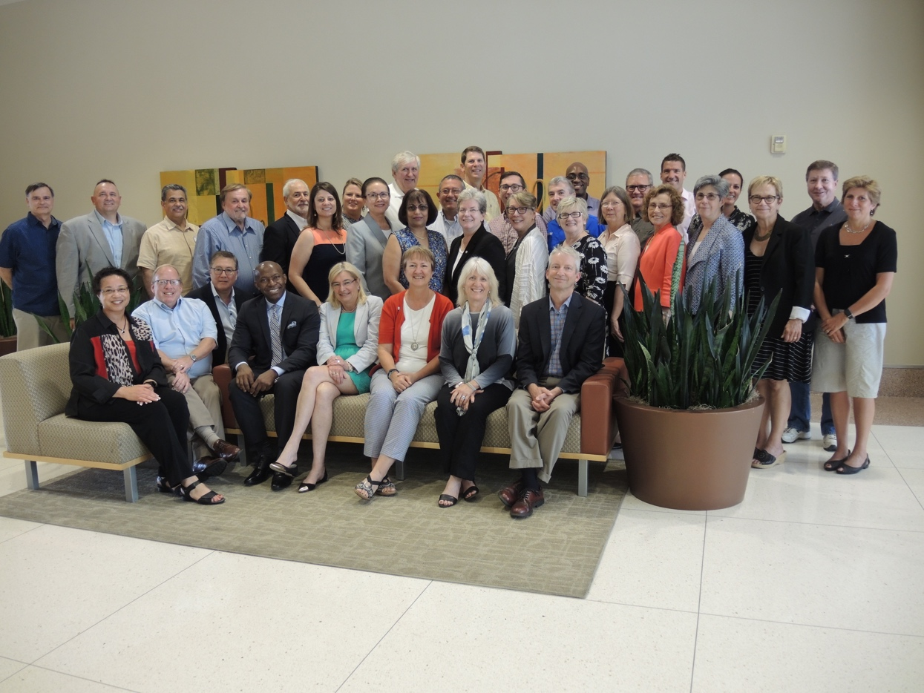
Digital Fellows: 2017-2019 at ASU Convening

Slide 6
Experiment
Each of these institutions, in addition to providing the CAOs with professional development about digital learning, was asked to choose a faculty champion and to help chose courseware. They would then run a pilot program on their campuses for one year. They were asked to write their findings in a final report in which they assess the progress made by their students. The most frequent way of doing this was to demonstrate that the number of DFWs decreased in the section(s) in which adaptive coureseware was deployed.
Findings indicated that the DFW number decreased in courses in which adaptive courseware was used.

Slide 7
Campus Teams and Grants: Operational Goals
All of the grantees were asked to do 5 operational things on their own campuses:
Identify assets (resources) that will be helpful to their institution in increasing learning in gateway and introductory courses.
Conduct a pilot on their campuses that will integrate digital courseware into the curriculum.
Make the adoption of digital courseware a strategic enterprise decision by institutional leaders.
Assess the success of the pilot on their campuses and present their projects as case studies.
Report on gains in retention and increased learning on their campuses.

Slide 8
Summary of Courseware Uses
Digital Courseware has opportunities for higher education in the areas of:
Developmental Mathematics, Pre-Calculus, and Calculus
Introductory courses in many Gateway disciplines
Courses in Chemistry and Physics, as well as in some areas of the liberal arts
such as History and English
Writing and composition courses
Specialty courses such as fisheries and the visual arts

Slide 9
Final Reports: 2019
For their final reports, the CAOs were asked to identify the top 5 findings about their projects and their experiences in these pilots.
By far the most frequent finding was the importance of faculty buy-in and engagement for the process and the pilots to be successful. Twenty-two of the 31 institutions responding identified this as the top finding.
As the CAO of Athens States University, Dr. Joe Delap states, “Once people learned to use the technology, they immediately implemented it with success.”

Slide 10
Final Reports
The second most frequent finding was the importance of leadership in embedding digital learning into the campus community. Thirteen institutions identified the importance of leadership as one of their top 5 findings.
Other findings included the need for clarity, the need to assess institutional context, the importance of student engagement, the cost, vendor relations, the learning curve and collaboration.
The early results point to the fact that our identification of high level leadership as essential to scale digital learning has been reinforced by the experiences of the Digital Fellows.

Slide 11
Regional Conferences Sponsored by ACAO Digital Fellows Program
Clark Atlanta University—HBCUs
Austin Community College—Texas Regional Institutions
Colorado State University—Colorado Regional Institutions
University of North Carolina Charlotte—North Carolina Regional Institutions
IUPUI—Indiana Regional Institutions
Nova Southeastern University—South Florida Institutions

Slide 12
Extension Projects
I have received an additional grant of $60,000 at the
end of 2020 to help provide webinars, mentoring and
resources to additional institutions in the Gates community
of grantees.
These services are being offered gratis to institutions on a
Request basis. Currently, I am working with Karen Vignare
at APLU to serve Fayetteville State University.
Services for mentoring will be needed in the future, and I would
Iike to call on members of the ACAO board and members of the
ACAO Advisory Council to serve as mentors.

